Slide 1

Recommendation ML Project
Intern: Sameen Chowdhury Supervisor: Niloy, Mukit
Time: July 23 - Aug 17

Slide 2


Objective
I have a dataset of 5,000 surveys conducted by 10-Minute School for customers, with 19 unique columns (features)
Find which features best correspond to the target variable, "How likely is the student to recommend 10MS to a friend?"
Make an effective model which is able to predict the outcome of how likely a customer is to recommend 10MS.
Notes:
intention to create a predictive model for customer recommendations based on the selected features.

Slide 3

Summary of the steps
Data Cleaning
Splitting data - training and testing
Finding best features - optimization
Scaling data (0-1) - efficiency with algorithms
Selecting best fit features
Experiment with algorithm - to select most accurate algorithm

Slide 4


Data Cleaning
2. Splitting data
Majority cleaned data
Some missing values were found
Convert input into numerical values
Data has been split into 2 categories for training models and testing models, ratio of 8:2

Slide 5
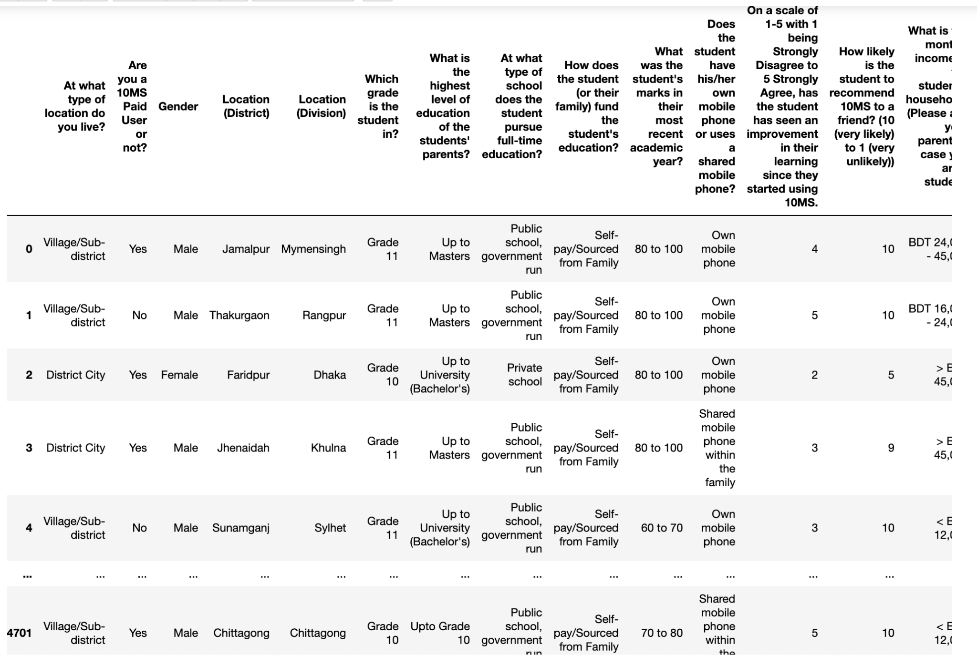
Before: Need to make these strings into numerical value for machines to read.

Slide 6
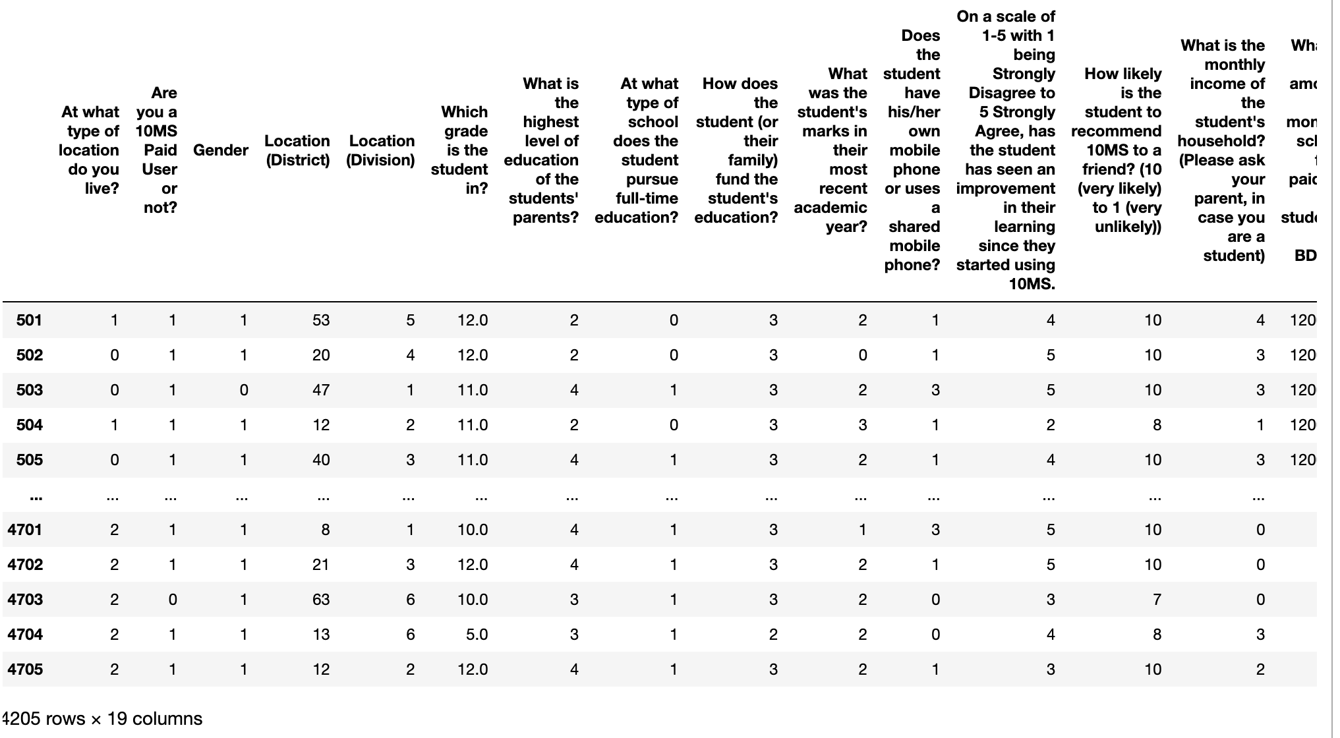
After: Machine readable converted numerical values.

Slide 7

3. Finding the best features
I used 5 different functions to examine each feature individually to determine the strength of the relationship between the features and the target feature (target value).
Notes:
we want to identify the features that have the highest correlation with our target values and use only those

Slide 8
5 functions & top correlated features.
SelectKBest() default function -
Has the student has seen an improvement in their learning since they started using 10MS?
If any, which of the following improvements has the student witnessed due to using 10MS?
Chi-squared -
What is the cost of after-school tuition class for the student, per subject per month?
What is the amount of monthly school fees paid for the student?
SelectKBest(mutual_info_classif) -
Has the student has seen an improvement in their learning since they started using 10MS
If any, which of the following improvements has the student witnessed due to using 10MS?
Decision Tree Regressor -
Are you a 10MS Paid User or not?
Gender
Recursive Feature Elimination - this involves iteratively eliminating features and building the model based on the remaining features, we were able to cross out 9 features with this.

Slide 9

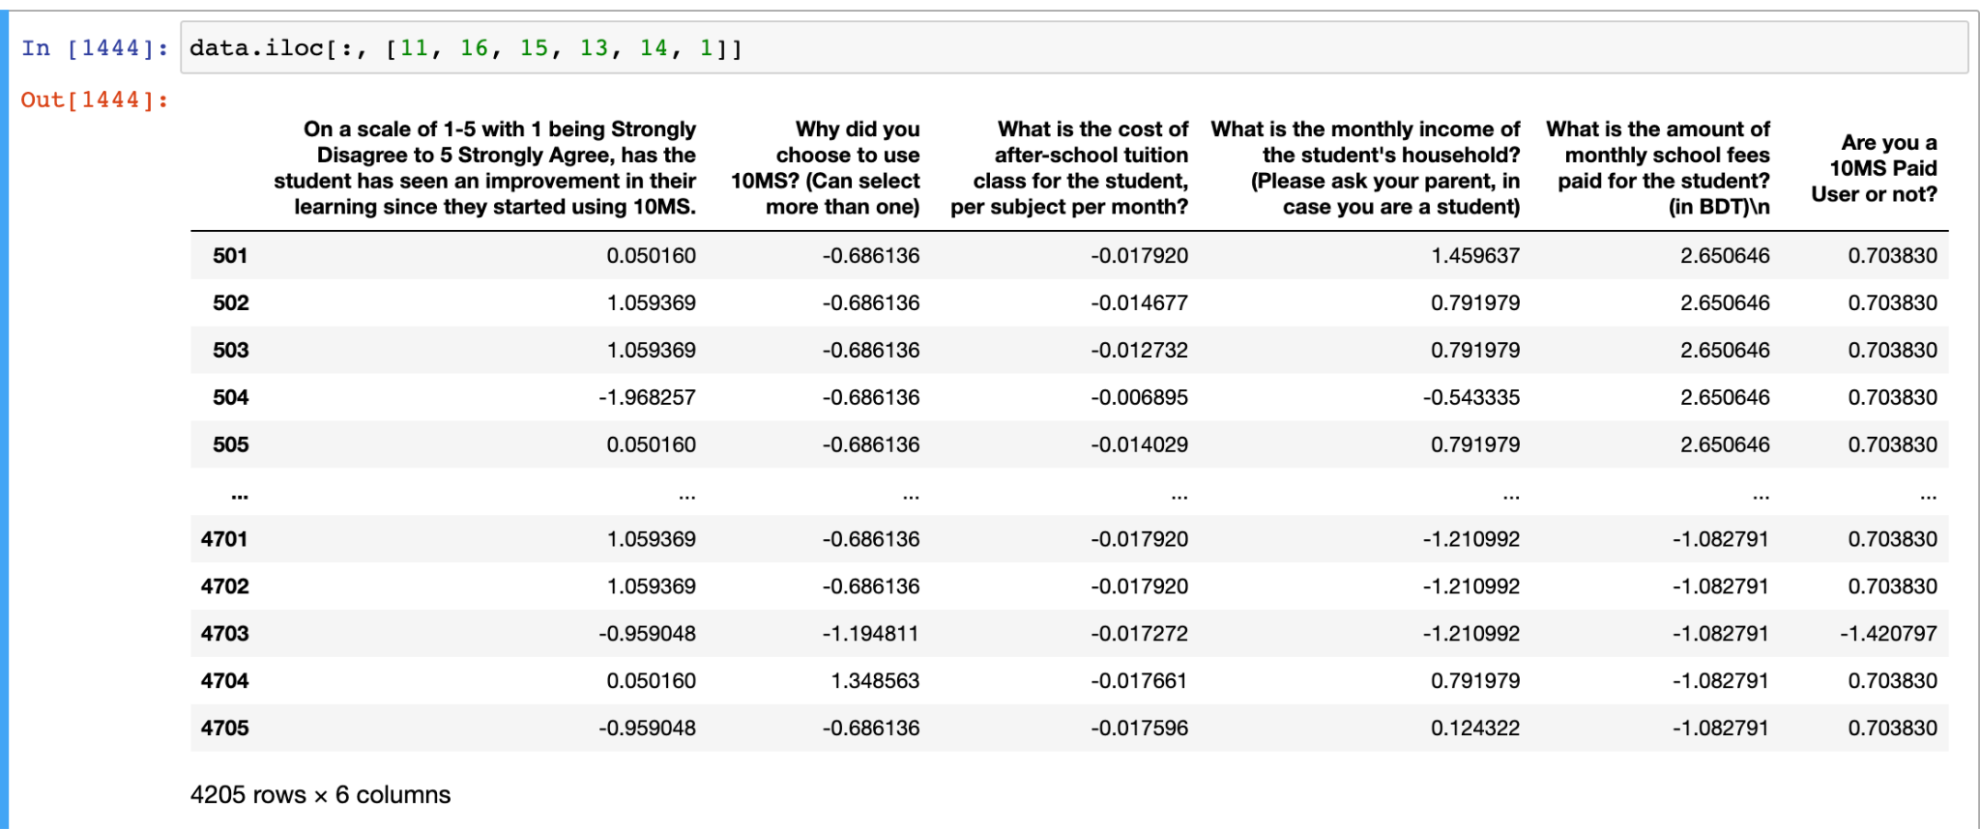
4. Scaling the data (0-1)
Majority of the Algorithms are more reliable when the data is scaled
All data is scaled to values of 0s and 1s
5. Selecting best fit features
The features which overlap the most among all the functions output are selected for our model

Slide 10


6. Experiment with multiple algorithms
Two steps -
Model Training: Train each selected algorithm using the training data.
Model Evaluation: Evaluate the performance of each model using appropriate evaluation metrics
Accuracy
R-Squared
Mean Absolute Error
Heat Map

Slide 11

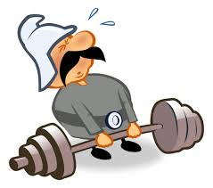
Tested 8 different algorithms
to cross examine and find the most optimized algorithm
~50% accuracy
<20% accuracy
LogisticRegression
LinearSVC
GaussianNB
GXBoost - Gradient boosting
LinearRegression
RandomForestRegressor
Sequential
DecisionTreeRegressor

Slide 12
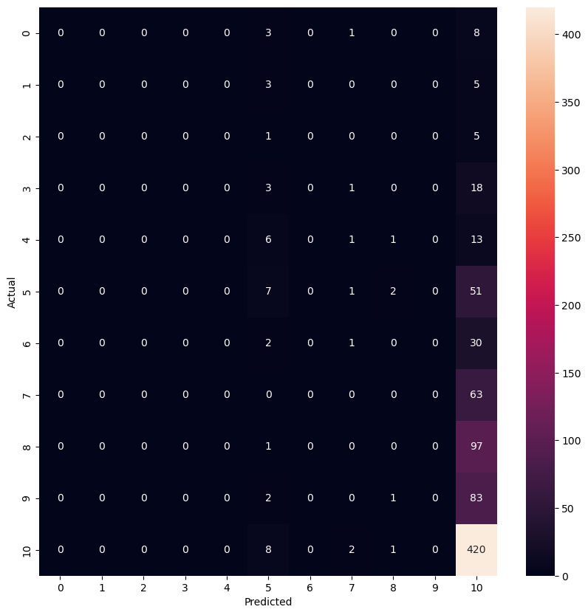

How likely is the student to recommend 10MS to a friend? (10 (very likely) to 1 (very unlikely))
Predicted vs Actual

Slide 13

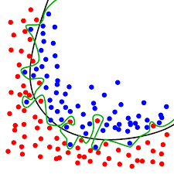
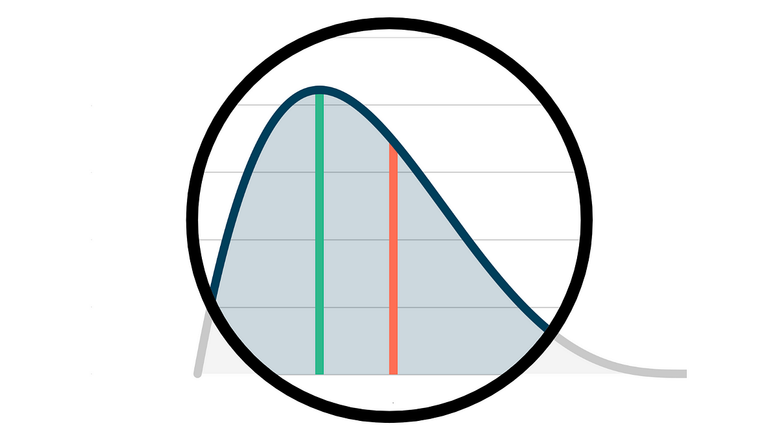
Why is my model not efficient?
Data is skewed
Outliers
Overfitting
Feature Scaling

Slide 14

Key takeaways and what would I do differently next time:
Spend more time with data cleaning
Try creating more minority data to balance the dataset
Find more outliers
Try different types of algorithms

Slide 15
Thank you!

